Slide 1
What the heck happened?
QA Tools – Squish & Test Center Thomas Piekarski Booth 21
STAREAST, Orlando, Wednesday, 27 April 2022

Slide 2

Agenda
1
Introduction
2
Live Demo
3
QA Tools
4
Wrap-up
5
Q&A

Slide 3

Introduction
All your tests have run successfully…

Slide 4

Introduction
All your tests have run successfully…
…and suddenly one test is failing…

Slide 5

Introduction
All your tests have run successfully…
…and suddenly one test is failing…
…what the heck happened?

Slide 6
Approaching failed tests
introduction
Verification message(s)

Slide 7
Approaching failed tests
introduction
Verification message(s)
Logs and output of stdout/stderr

Slide 8
Approaching failed tests
introduction
Verification message(s)
Logs and output of stdout/stderr
Call stacks, requests and responses

Slide 9
Approaching failed tests
introduction
Verification message(s)
Logs and output of stdout/stderr
Call stacks, requests and responses
Version Control History

Slide 10
Approaching failed tests
introduction
Verification message(s)
Logs and output of stdout/stderr
Call stacks, requests and responses
Version Control History
Scattering print statements

Slide 11
Approaching failed tests
introduction
Verification message(s)
Logs and output of stdout/stderr
Call stacks, requests and responses
Version Control History
Scattering print statements
Stepping with a debugger

Slide 12
Approaching failed tests
introduction
Verification message(s)
Logs and output of stdout/stderr
Call stacks, requests and responses
Version Control History
Scattering print statements
Stepping with a debugger
Screenshots

Slide 13
Approaching failed tests
introduction
Verification message(s)
Logs and output of stdout/stderr
Call stacks, requests and responses
Version Control History
Scattering print statements
Stepping with a debugger
Screenshots
Google…

Slide 14
Approaching failed tests
introduction
Verification message(s)
Logs and output of stdout/stderr
Call stacks, requests and responses
Version Control History
Scattering print statements
Stepping with a debugger
Screenshots
Google…
…and of course, your colleague next door!

Slide 15
Approaching failed tests
introduction
Verification message(s)
Logs and output of stdout/stderr
Call stacks, requests and responses
Version Control History
Scattering print statements
Stepping with a debugger
Screenshots
Google…
…and of course, your colleague next door!

Slide 16
Approaching failed tests
introduction
Verification message(s)
Logs and output of stdout/stderr
Call stacks, requests and responses
Version Control History
Scattering print statements
Stepping with a debugger
Screenshots
Google…
…and of course, your colleague next door!
Is this enough to pinpoint a failure?

Slide 17
A picture is worth
a thousand words.

Slide 18
Approaching failed tests
Introduction
Video captured during test runs

Slide 19
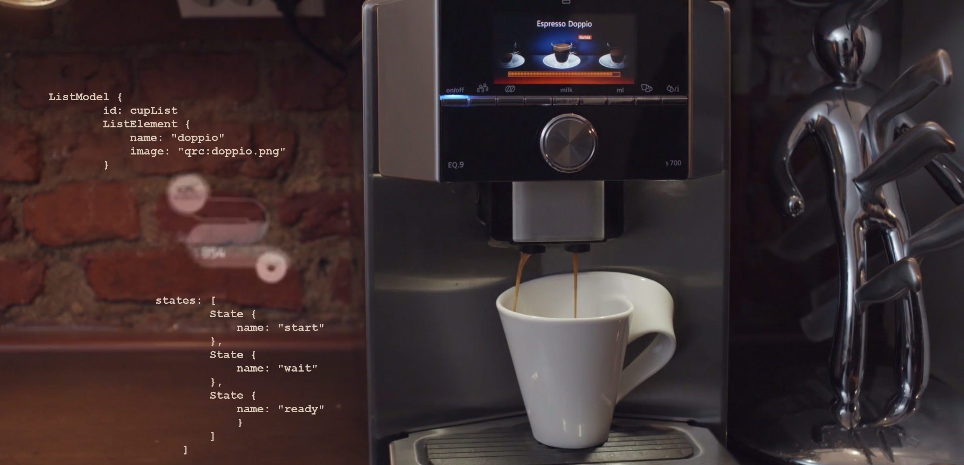
2
Live Demo – Testing a Coffee Machine

Slide 20
Hands-on
Live Demo
Introduce you to our Coffee Machine
How would you test this machine?
Let’s test it a little bit

Slide 21
Hands-on
Live Demo
Introduce you to our Coffee Machine
How would you test this machine?
Let’s test it a little bit
Record and Replay a test
Verify a state by comparing text or screenshot
Let’s break a test

Slide 22
Hands-on
Live Demo
Introduce you to our Coffee Machine
How would you test this machine?
Let’s test it a little bit
Record and Replay a test
Verify a state by comparing text or screenshot
Let’s break a test
Skim results of such tests in Test Center

Slide 23
Hands-on
Live Demo
Introduce you to our Coffee Machine
How would you test this machine?
Let’s test it a little bit
Record and Replay a test
Verify a state by comparing text or screenshot
Let’s break a test
Skim results of such tests in Test Center
Take a close look at one failed test in Squish

Slide 24
Hands-on
Live Demo
Introduce you to our Coffee Machine
How would you test this machine?
Let’s test it a little bit
Record and Replay a test
Verify a state by comparing text or screenshot
Let’s break a test
Skim results of such tests in Test Center
Take a close look at one failed test in Squish
Let’s together investigate the failed test

Slide 25
Hands-on
Live Demo
Introduce you to our Coffee Machine
How would you test this machine?
Let’s test it a little bit
Record and Replay a test
Verify a state by comparing text or screenshot
Let’s break a test
Skim results of such tests in Test Center
Take a close look at one failed test in Squish
Let’s together investigate the failed test

Slide 26
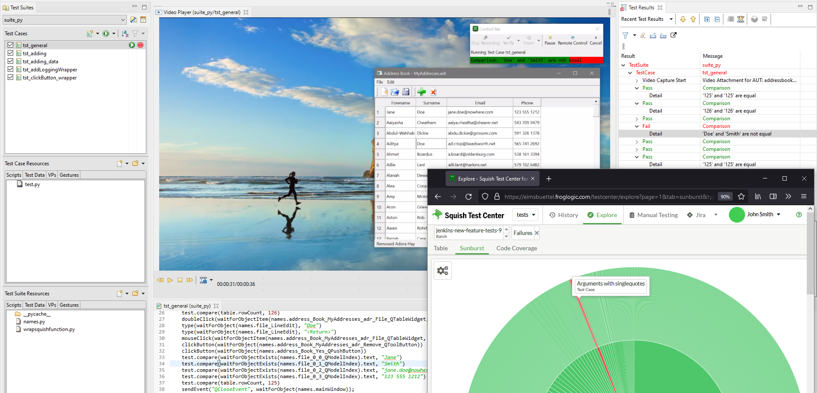
3
QA Tools

Slide 27

QA Tools
Squish
Multi-platform, object-aware automated GUI testing for virtually any toolkit

Slide 28

QA Tools
Squish
Multi-platform, object-aware automated GUI testing for virtually any toolkit
Coco
Cross-platform, cross-compiler advanced code coverage analysis & Tool Qualification

Slide 29

QA Tools
Squish
Multi-platform, object-aware automated GUI testing for virtually any toolkit
Coco
Cross-platform, cross-compiler advanced code coverage analysis & Tool Qualification
Test Center
Centralized test result management platform connecting automation with the entire dev process

Slide 30
QA Tools
Squish
Coco
Test Center
Notes:
…this session will focus on Squish (GUI Tester) and Test Center…

Slide 31
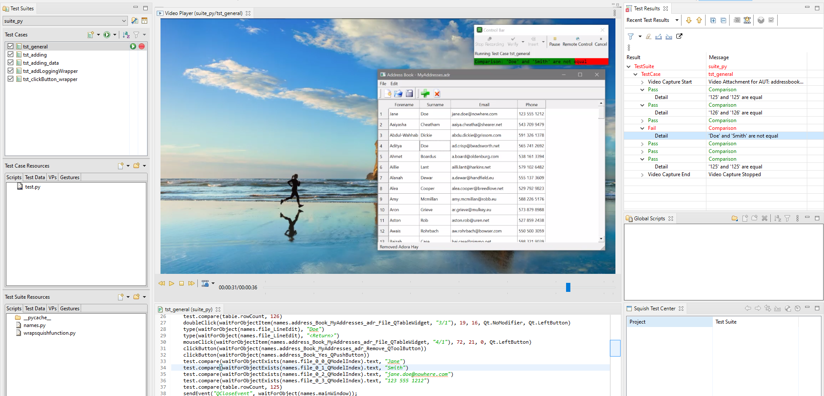
3.1
Overview of Squish GUI Tester
Notes:
Todo: add screenshot of Squish IDE / Squish Runner Output

Slide 32

Squish Quick Features
QA Tools
1
Recording and Replaying of Tests
2
Script- and BDD-based Test Development
3
Object-, Image- and OCR-driven

Slide 33
Squish Quick Features
QA Tools
4
Test across platforms and devices
5
Powerful IDE and Integration in CI
6
Video Capture

Slide 34
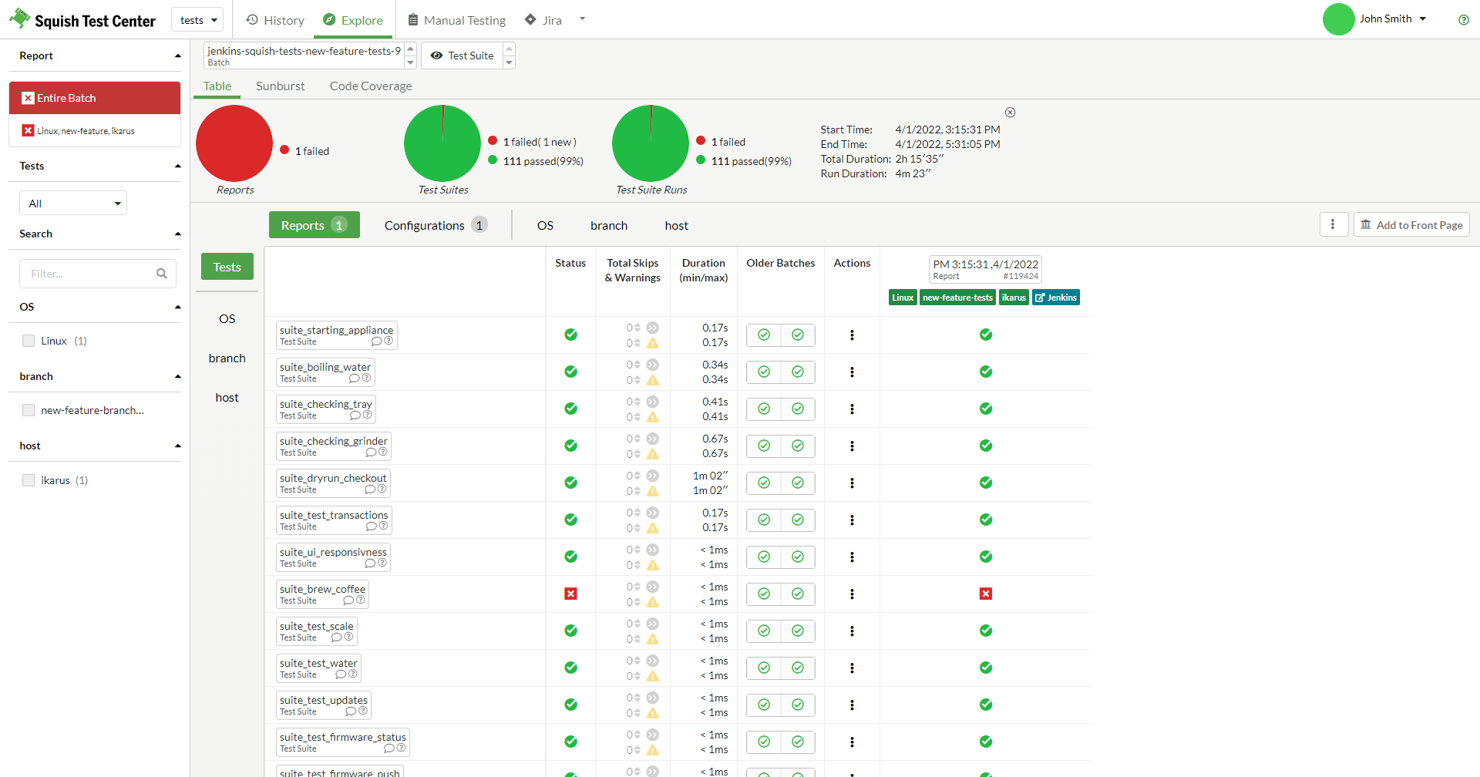
3.2
Overview of Test Center
Notes:
Todo: Add Screenshot of Test Center

Slide 35
Test Center Quick Features
QA Tools
1
Central dashboard for test results
2
Stream captured videos
3
Manage your tests from anywhere

Slide 36

Customers
QA Tools
Notes:
What customers to highlight and mention when passing this slide? With the States in mind, maybe: Disney, GE, Google, Pfizer and US Navy

Slide 37
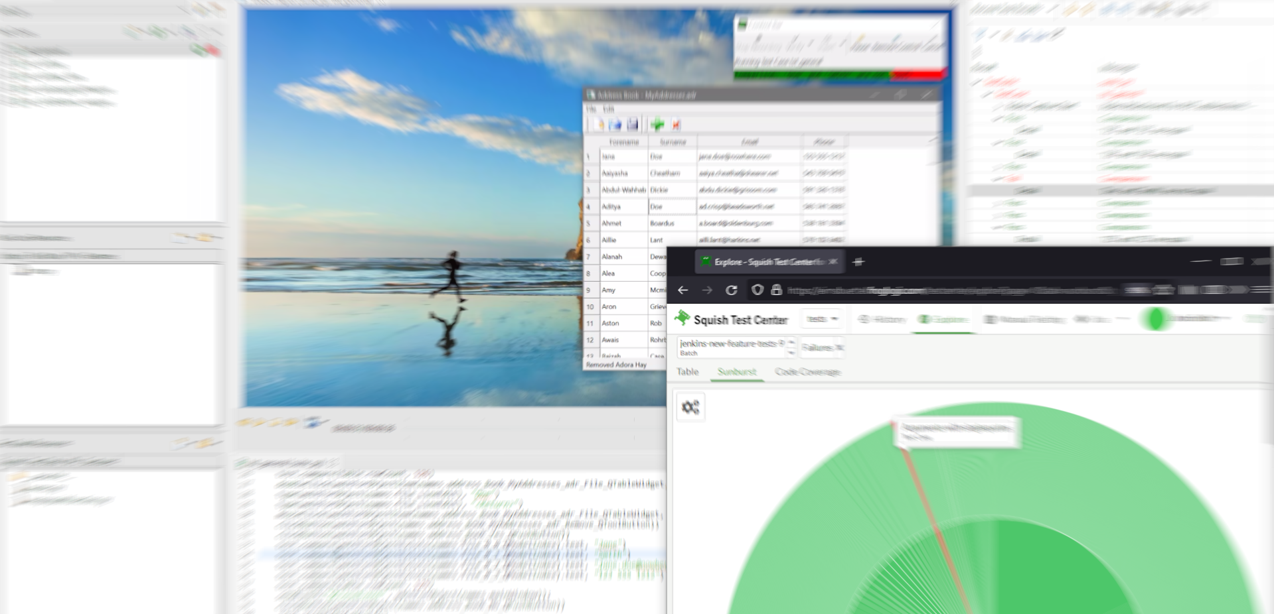
4
Wrap-up

Slide 38
Wrap-up
What the heck happened?
Record and Replay tests

Slide 39
Wrap-up
What the heck happened?
Record and Replay tests
Verifying values and screenshots

Slide 40
Wrap-up
What the heck happened?
Record and Replay tests
Verifying values and screenshots
How to break tests

Slide 41
Wrap-up
What the heck happened?
Record and Replay tests
Verifying values and screenshots
How to break tests
Different ways to approach failing tests

Slide 42
Wrap-up
What the heck happened?
Record and Replay tests
Verifying values and screenshots
How to break tests
Different ways to approach failing tests
Video is one piece in this puzzle

Slide 43
Wrap-up
What the heck happened?
Record and Replay tests
Verifying values and screenshots
How to break tests
Different ways to approach failing tests
Video is one piece in this puzzle
Develop tests with Squish

Slide 44
Wrap-up
What the heck happened?
Record and Replay tests
Verifying values and screenshots
How to break tests
Different ways to approach failing tests
Video is one piece in this puzzle
Develop tests with Squish
One way to automate manual testing

Slide 45
Wrap-up
What the heck happened?
Record and Replay tests
Verifying values and screenshots
How to break tests
Different ways to approach failing tests
Video is one piece in this puzzle
Develop tests with Squish
One way to automate manual testing
Manage test results with Test Center

Slide 46
Wrap-up
What the heck happened?
Record and Replay tests
Verifying values and screenshots
How to break tests
Different ways to approach failing tests
Video is one piece in this puzzle
Develop tests with Squish
One way to automate manual testing
Manage test results with Test Center
One way to handle the ever-growing number of test results

Slide 47
Wrap-up
What the heck happened?
Record and Replay tests
Verifying values and screenshots
How to break tests
Different ways to approach failing tests
Video is one piece in this puzzle
Develop tests with Squish
One way to automate manual testing
Manage test results with Test Center
One way to handle the ever-growing number of test results

Slide 48

Q&A
Let’s discuss your questions now!

Slide 49
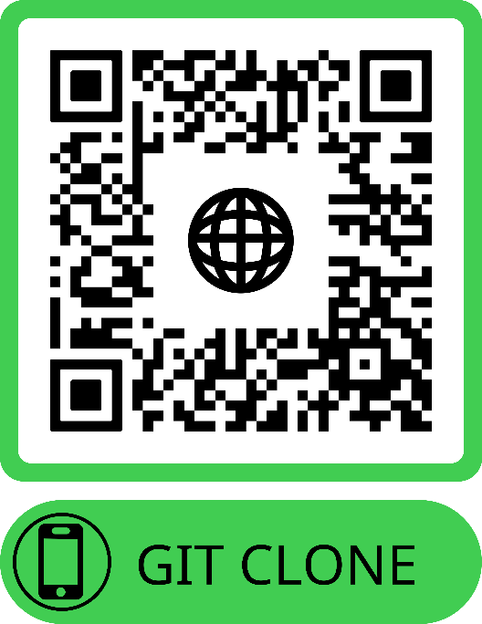
Thank you, let’s have a coffee and see you at our booth 21!
Demo Repository https://qrco.de/stareast-22-qt-demo
Jan Aarsaether jan.aarsaether@qt.io
Thomas Piekarski thomas.piekarski@qt.io

Slide 50
Backup Slides

Slide 51
Tests are still running…
What the heck happened?
Further Q&A and open discussion
What pain points do you encounter when testing software?
How do you approach a failed test?
Do you have any preferred way of approaching?
Did you leverage video for debugging tests in the past?
What do you expect from a captured video?

Slide 52
Thank you, all tests finished, see you at our booth 21!
Jan Aarsaether jan.aarsaether@qt.io
Thomas Piekarski thomas.piekarski@qt.io

